Slide 1

COMPUTER VISION
Intro to Deep Learning

Slide 2
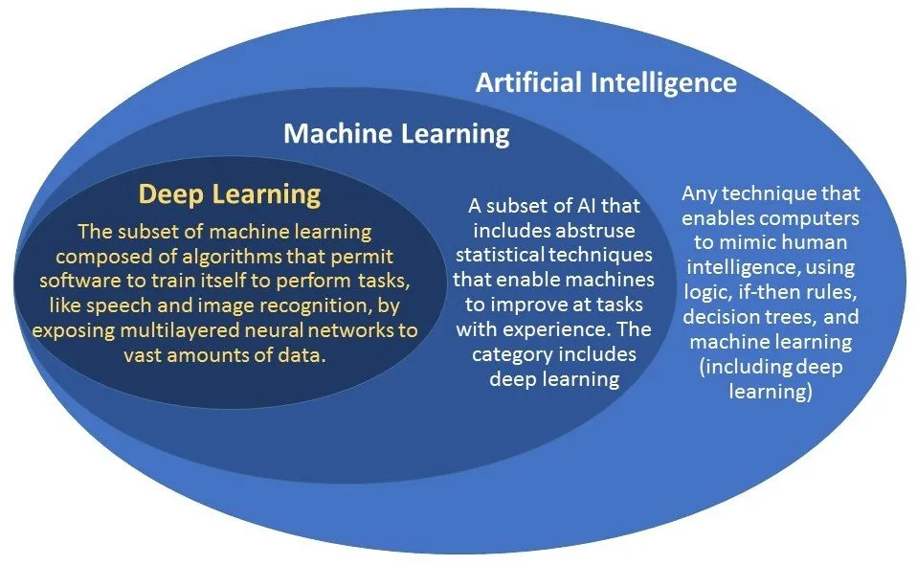

Slide 3
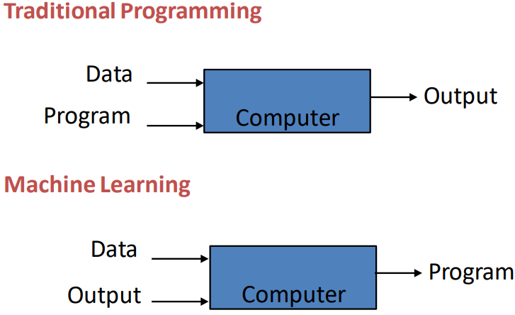
MACHINE LEARNING
The study of algorithms that:
improve their performance P
at some task T
With experience E
for a well-defined learning task is given by <P, T, E>.

Slide 4
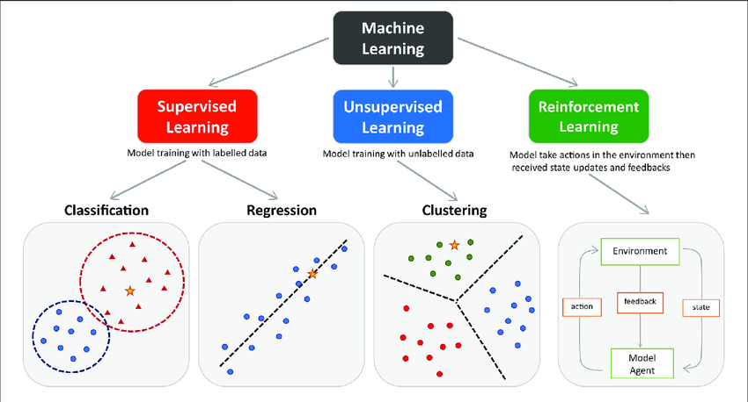

Slide 5

ML PROCESS

Slide 6
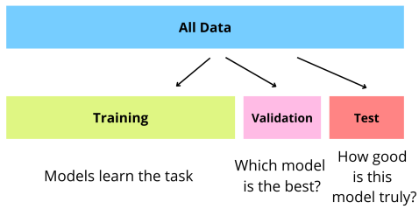
DATASET
Collection of data used for training, testing, and evaluating a model.
Serves as the foundation for building and validating machine learning algorithms.
Typically consists of input features and corresponding output labels.

Slide 7
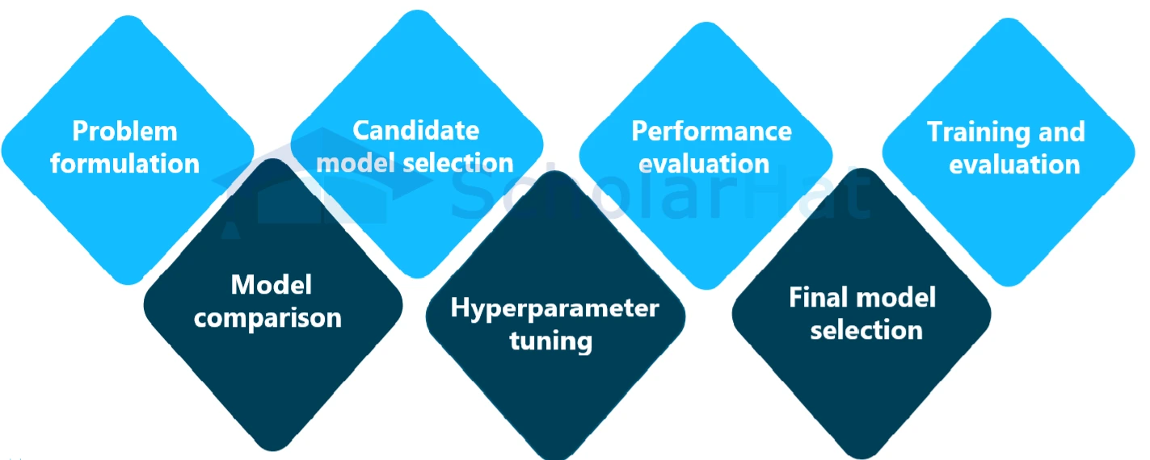
MODEL TRAINING

Slide 8
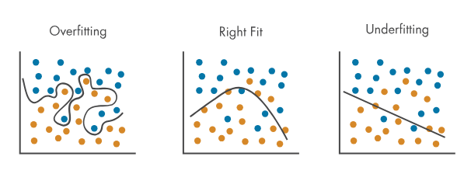
TESTING

Slide 9
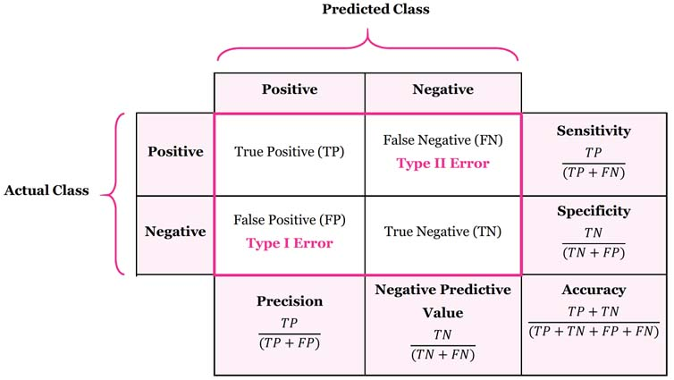

Slide 10
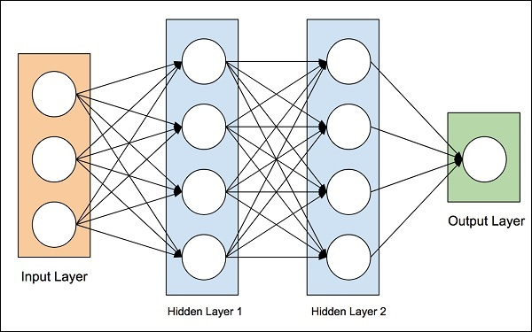
DEEP LEARNING
Subset of machine learning that focuses on the use of artificial neural networks to enable machines to learn and make decisions by learning from input data.
It can automatically learn hierarchical representations of data through the use of neural networks with multiple layers.

Slide 11
WHY DL?
Automatic feature extraction.
Robustness to input variability.
Handles large volumes of data.
Improved performance in complex tasks like computer vision, NLP, etc.
Enough hardware processing capacity through GPUs and TPUs.
Availability of open-source frameworks like TensorFlow and PyTorch for training DL models.

Slide 12



DL FRAMEWORKS
Libraries that provide accessible and scalable tools required to streamline the development, training, and deployment of deep learning models.
Allowing developers to focus on model architecture and application logic without delving into the intricacies of low-level mathematical operation behind the models.
Performs computations efficiently by leveraging parallel processing and GPU acceleration to speed up training.
Commonly used frameworks are TensorFlow by Google and PyTorch by Meta.

Slide 13
DL ARCHITECTURES
Specific structures and configurations of neural networks used for various tasks. For example:
Artificial NN (ANN) - Basic type of NN.
Convolutional NN (CNN) - Used for computer vision applications.
Recurrent NN (RNN) - Suitable for sequence data, such as time series or natural language.
Generative Adversarial Networks (GAN) - Backbone of Generative AI.

Slide 14
ANN

Slide 15
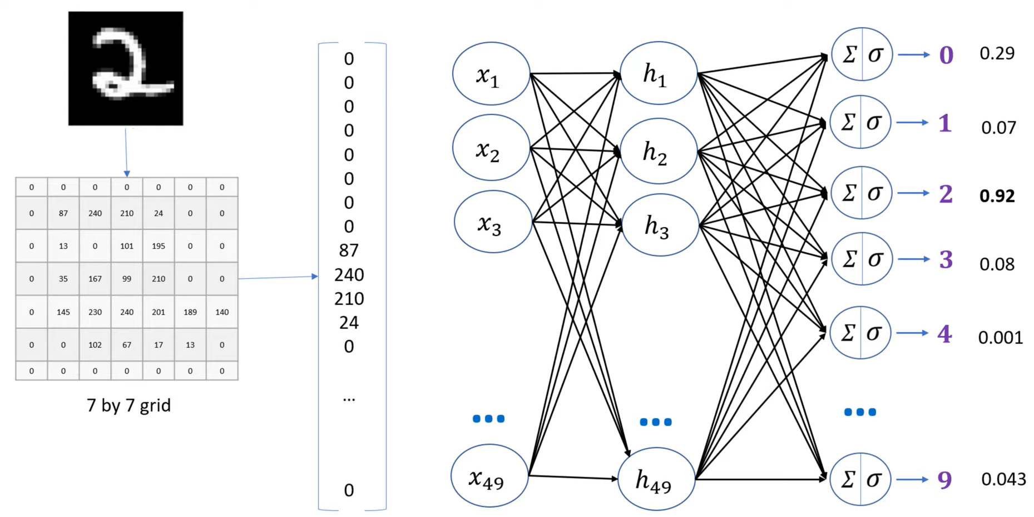

Slide 16
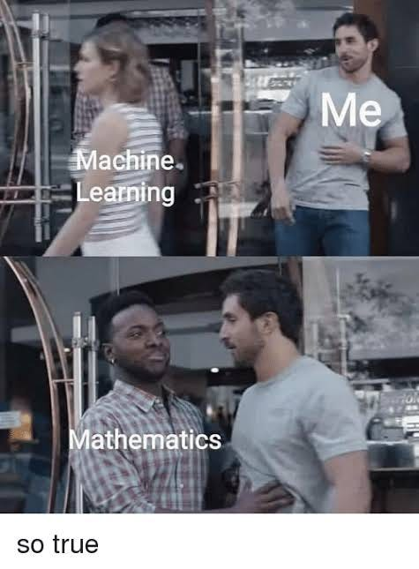

Slide 17
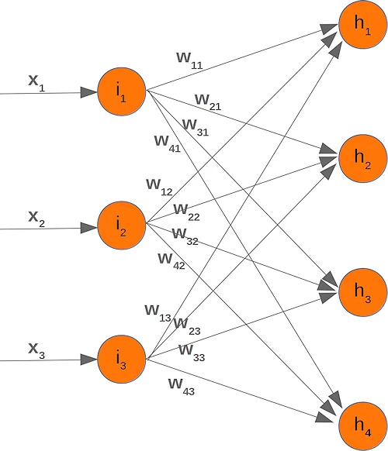

Slide 18
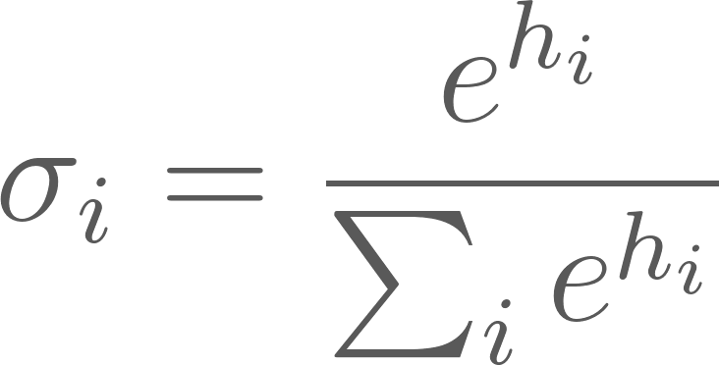
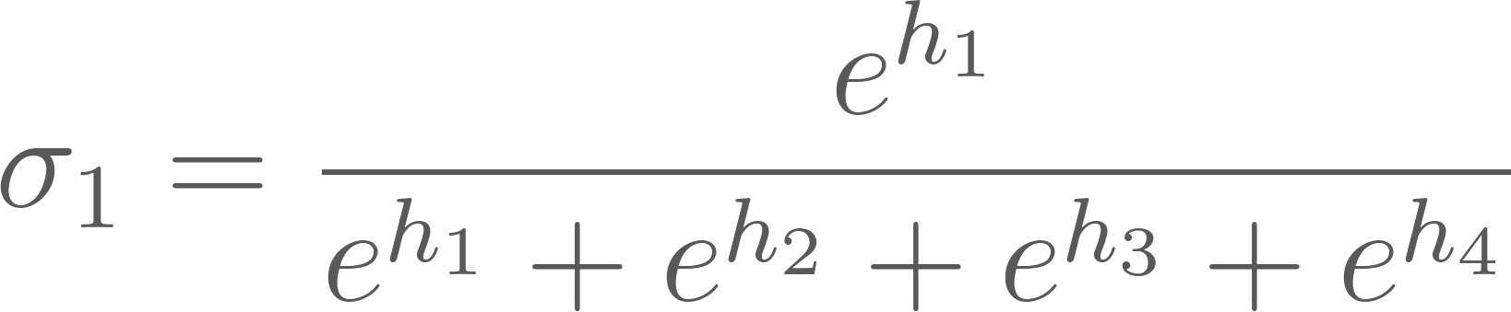
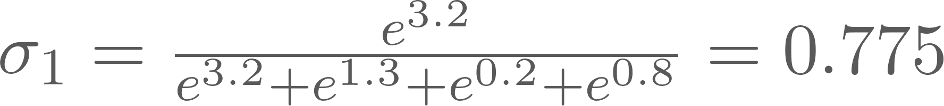

Slide 19
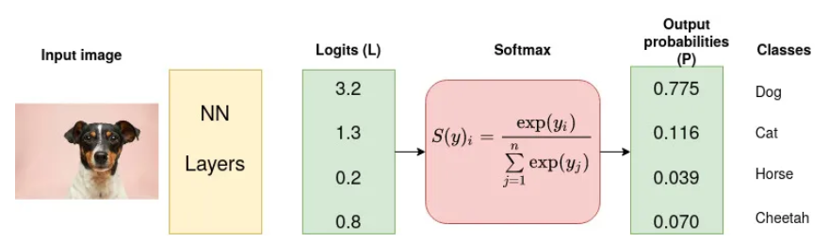

Slide 20

CNN

Slide 21
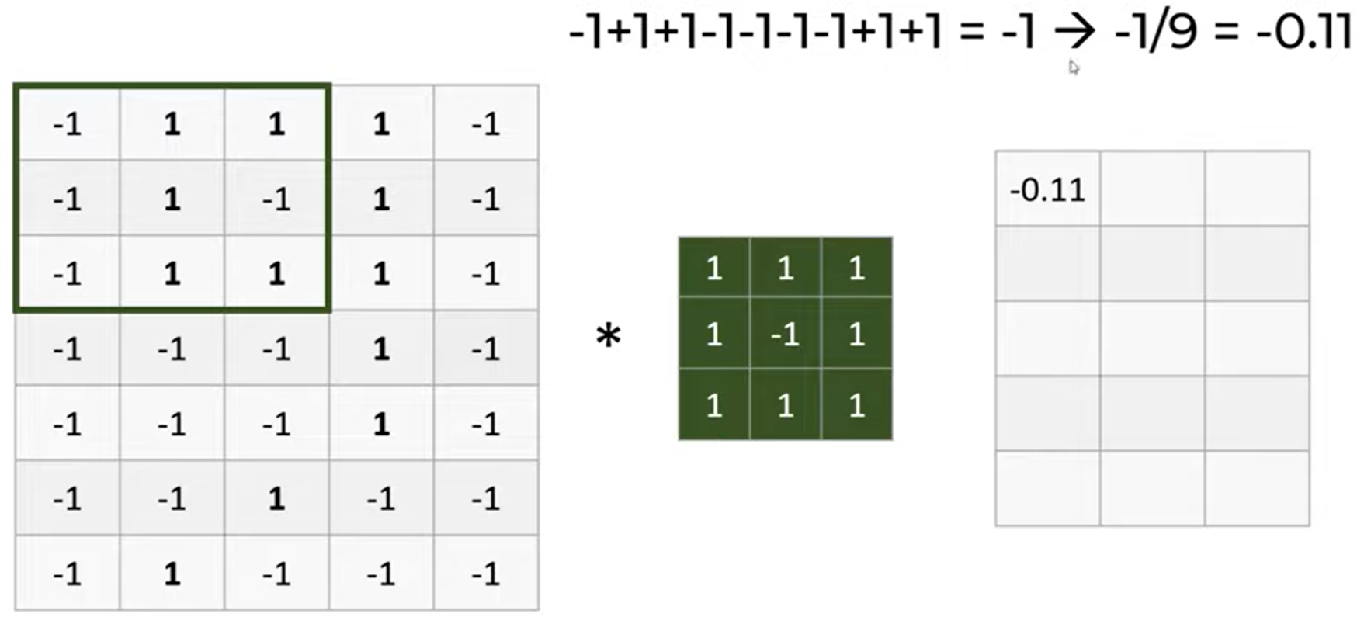
CONVOLUTION

Slide 22
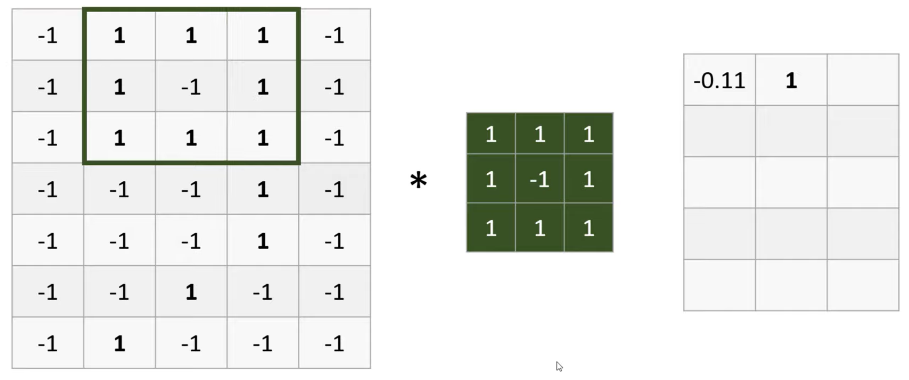

Slide 23
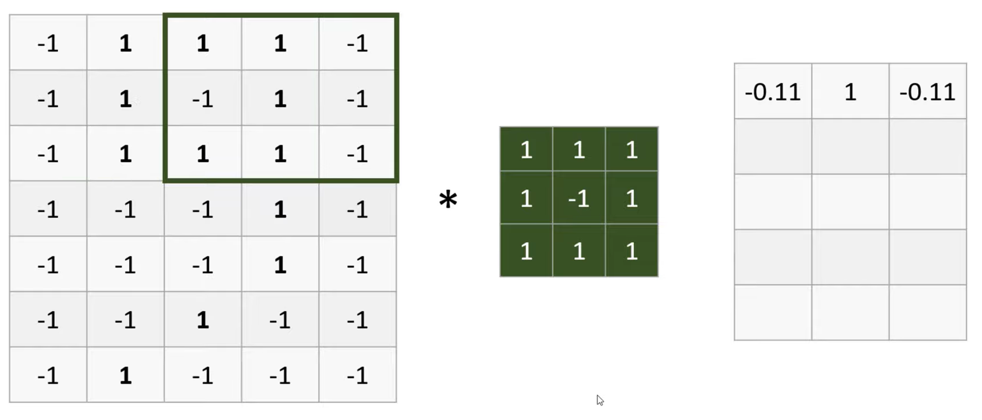

Slide 24
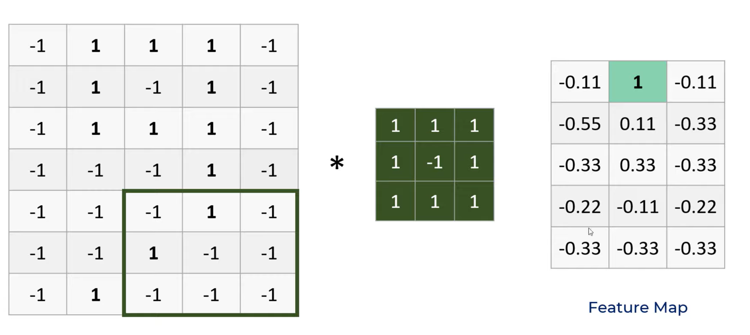

Slide 25
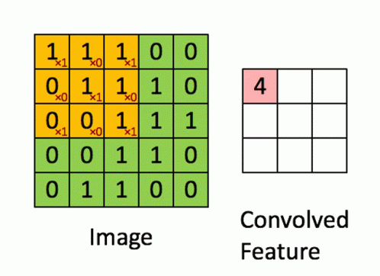

Slide 26
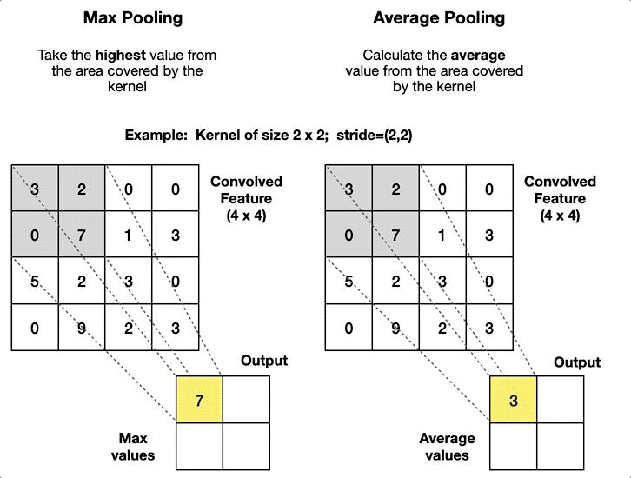

Slide 27
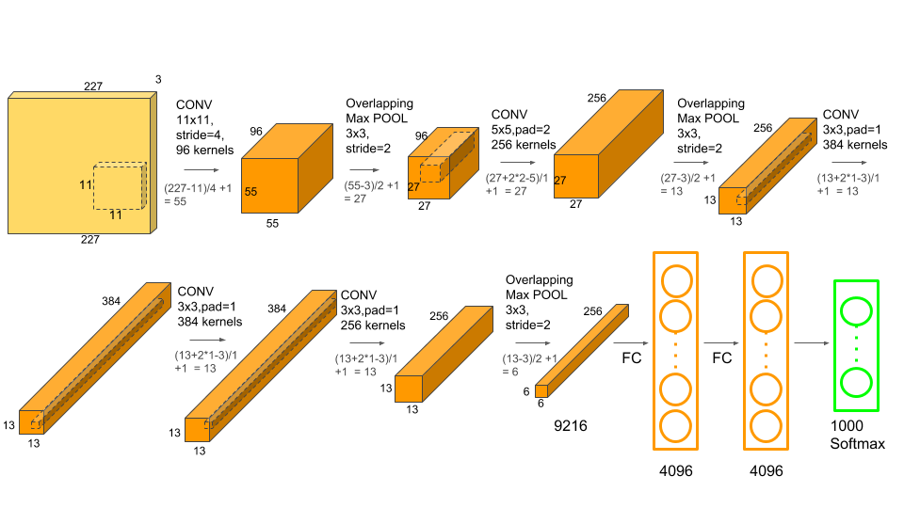

Slide 28
RECOMMENDED RESOURCES
Prof. Andrew Ng’s deep learning specialization (Coursera | YT) 🚩🚩
3b1b’s deep learning YT playlist to understand mathematical intuitions behind neural networks 🚩
“Deep Learning” book by Ian Goodfellow et al.
TensorFlow Tutorial on YT

